Slide 1
CS630 AI Agent Engineering Module 06 Experiencing Persistent Storage
Core Concepts of SQL, SQLite, CRUD, DatabaseSessionService
Session Lifecycle, Event Loop
Logic Flow of Memory Agent using DatabaseSessionService
State vs Memory
Memory Agent: CRUD functions
Inspecting SQLite Tables

Slide 2
Core Concepts
SQL
SQLite
CRUD
DatabaseSessionService
(Google, 2025)

Slide 3
SQL
Structured Query Language (SQL) is a domain-specific language used to manage data, especially in a relational database management system (RDBMS). It is particularly useful in handling structured data, i.e., data incorporating relations among entities and variables.

Slide 4
SQLite
SQLite is a C-language library that implements a small, fast, self-contained, high-reliability, full-featured, SQL database engine.
SQLite is the most used database engine in the world. SQLite is built into all mobile phones and most computers and comes bundled inside countless other applications that people use every day

Slide 5
CRUD
In computer programming, create, read, update, and delete (CRUD) are the four basic operations (actions) of persistent storage.
CRUD is also sometimes used to describe user interface conventions that facilitate viewing, searching, and changing information using computer-based forms and reports.

Slide 6
CRUD with Python and SQLite Setup and Connection
import sqlite3 def get_connection(): """Establishes a connection to the SQLite database.""" try: conn = sqlite3.connect('database.db') return conn except sqlite3.Error as e: print(f"Error connecting to database: {e}") return None

Slide 7
CRUD with Python and SQLite CREATE
def create_table(conn): """Creates a 'users' table if it doesn't already exist.""" cursor = conn.cursor() cursor.execute(''' CREATE TABLE IF NOT EXISTS users ( id INTEGER PRIMARY KEY, name TEXT NOT NULL, email TEXT UNIQUE NOT NULL ) ''') conn.commit() print("Table 'users' created successfully.") def create_user(conn, name, email): """Inserts a new user into the 'users' table.""" cursor = conn.cursor() try: cursor.execute("INSERT INTO users (name, email) VALUES (?, ?)", (name, email)) conn.commit() print(f"User '{name}' created successfully.") except sqlite3.IntegrityError: print(f"Error: A user with email '{email}' already exists.")

Slide 8
CRUD with Python and SQLite READ
def read_all_users(conn): """Fetches and prints all users from the 'users' table.""" cursor = conn.cursor() cursor.execute("SELECT * FROM users") users = cursor.fetchall() print("\n--- All Users ---") for user in users: print(f"ID: {user[0]}, Name: {user[1]}, Email: {user[2]}") print("-----------------\n") def read_user_by_email(conn, email): """Fetches a single user by their email.""" cursor = conn.cursor() cursor.execute("SELECT * FROM users WHERE email = ?", (email,)) user = cursor.fetchone() if user: print(f"Found user: ID: {user[0]}, Name: {user[1]}, Email: {user[2]}") return user else: print(f"No user found with email '{email}'.") return None

Slide 9
CRUD with Python and SQLite UPDATE
def update_user_name(conn, email, new_name): """Updates the name of a user based on their email.""" cursor = conn.cursor() cursor.execute("UPDATE users SET name = ? WHERE email = ?", (new_name, email)) conn.commit() if cursor.rowcount > 0: print(f"Name updated for user with email '{email}'.") else: print(f"No user found with email '{email}' to update.")

Slide 10
CRUD with Python and SQLite DELETE
def delete_user(conn, email): """Deletes a user from the 'users' table by their email.""" cursor = conn.cursor() cursor.execute("DELETE FROM users WHERE email = ?", (email,)) conn.commit() if cursor.rowcount > 0: print(f"User with email '{email}' deleted successfully.") else: print(f"No user found with email '{email}' to delete.")

Slide 11
DatabaseSessionService: SQLite
How it works: Connects to a relational database (e.g., PostgreSQL, MySQL, SQLite) to store session data persistently in tables.
Persistence: Yes. Data survives application restarts.
Requires: A configured database.
Best for: Applications needing reliable, persistent storage that you manage yourself.
(Google, 2025)

Slide 12
DatabaseSessionService: SQLite
from google.adk.sessions import DatabaseSessionService
# Example using a local SQLite file: db_url = "sqlite:///./my_agent_data.db" session_service = DatabaseSessionService(db_url=db_url)
(Google, 2025)

Slide 13
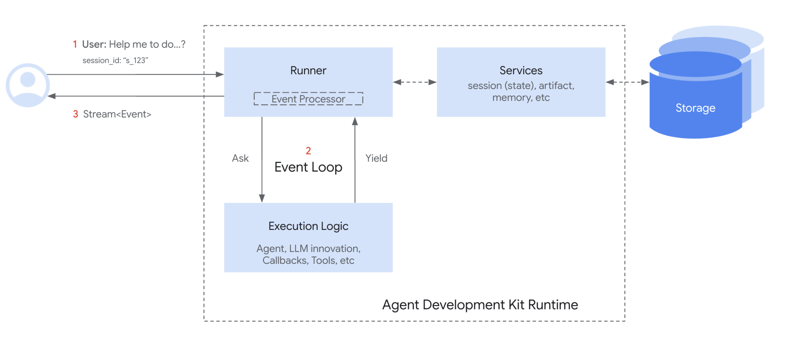
The Session Lifecycle
(Google, 2025)
Notes:
Here’s a simplified flow of how Session and SessionService work together during a conversation turn:
Start or Resume: Your application needs to use the SessionService to either create_session (for a new chat) or use an existing session id.
Context Provided: The Runner gets the appropriate Session object from the appropriate service method, providing the agent with access to the corresponding Session's state and events.
Agent Processing: The user prompts the agent with a query. The agent analyzes the query and potentially the session state and events history to determine the response.
Response & State Update: The agent generates a response (and potentially flags data to be updated in the state). The Runner packages this as an Event.
Save Interaction: The Runner calls sessionService.append_event(session, event) with the session and the new event as the arguments. The service adds the Event to the history and updates the session's state in storage based on information within the event. The session's last_update_time also get updated.
Ready for Next: The agent's response goes to the user. The updated Session is now stored by the SessionService, ready for the next turn (which restarts the cycle at step 1, usually with the continuation of the conversation in the current session).
End Conversation: When the conversation is over, your application calls sessionService.delete_session(...) to clean up the stored session data if it is no longer required.

Slide 14
Logic Flow of Memory Agent using DatabaseSessionService
Initialize Persistent Session Service
Define Initial State
Session Management – Find or Create
Check existing sessions, create new if none.
Agent Runner Setup
Interactive Conversation Loop
(Hancock, 2025)

Slide 15
Logic Flow: Part 1
# ===== PART 1: Initialize Persistent Session Service ===== # Using SQLite database for persistent storage db_url = "sqlite:///./my_agent_data.db" session_service = DatabaseSessionService(db_url=db_url)
(Hancock, 2025)

Slide 16
Logic Flow: Part 2
# ===== PART 2: Define Initial State ===== # This will only be used when creating a new session initial_state = { "user_name": "Clark Ngo", "reminders": [], }
(Hancock, 2025)

Slide 17
Logic Flow: Part 3
# ===== PART 3: Session Management - Find or Create ===== # Check for existing sessions for this user existing_sessions = await session_service.list_sessions( app_name=APP_NAME, user_id=USER_ID, ) # If there's an existing session, use it, otherwise create a new one if existing_sessions and len(existing_sessions.sessions) > 0: # Use the most recent session SESSION_ID = existing_sessions.sessions[0].id print(f"Continuing existing session: {SESSION_ID}") else: # Create a new session with initial state new_session = await session_service.create_session( app_name=APP_NAME, user_id=USER_ID, state=initial_state, ) SESSION_ID = new_session.id print(f"Created new session: {SESSION_ID}")
(Hancock, 2025)
Notes:
This code block is a core part of a session management system, likely within an application using the Google Agent Development Kit (ADK) or a similar conversational AI framework. Its primary purpose is to find an active session for a specific user or create a new one if none exists.
How It Works
This logic ensures a continuous conversation experience by linking a user's new message to their ongoing chat history.
Step-by-Step Breakdown
1. Check for Existing Sessions: The code first calls session_service.list_sessions(). This function queries the session service (which could be backed by a database like SQLite or a more scalable service) for all active sessions associated with a specific user (USER_ID) and application (APP_NAME). It retrieves a list of these sessions.
2. Find a Session or Create a New One:
Find: The if condition if existing_sessions and len(existing_sessions.sessions) > 0: checks if the list returned in the previous step contains any sessions. If it does, the code assumes the first session in the list (existing_sessions.sessions[0]) is the most recent or relevant one and reuses it by assigning its id to the SESSION_ID variable. This allows the conversation to continue from where it left off.
Create: If no existing sessions are found (the list is empty), the else block is executed. It calls session_service.create_session() to generate a new session. The user_id, app_name, and an initial_state are passed as parameters. The initial_state can be used to set up default values for the new conversation. The id of this newly created session is then assigned to SESSION_ID.
Importance of Session Management
This simple find-or-create logic is fundamental for:
State Persistence: It allows the application to maintain the conversational state (e.g., user's name, previous questions, or context) across multiple messages.
Efficiency: It prevents the creation of a new session for every single user message, saving resources and keeping the database clean.
Continuity: It ensures that a user's interaction feels like a single, ongoing conversation rather than a series of disconnected requests.

Slide 18
Logic Flow: Part 4
# ===== PART 4: Agent Runner Setup ===== # Create a runner with the memory agent runner = Runner( agent=memory_agent, app_name=APP_NAME, session_service=session_service, )
(Hancock, 2025)

Slide 19
Logic Flow: Part 5
# ===== PART 5: Interactive Conversation Loop ===== print("\nWelcome to Memory Agent Chat!") print("Your reminders will be remembered across conversations.") print("Type 'exit' or 'quit' to end the conversation.\n") while True: # Get user input user_input = input("You: ") # Check if user wants to exit if user_input.lower() in ["exit", "quit"]: print("Ending conversation. Your data has been saved to the database.") break # Process the user query through the agent await call_agent_async(runner, USER_ID, SESSION_ID, user_input)
(Hancock, 2025)

Slide 20
Call Agent Async
Parameters: runner, user_id, session_id, query
Content: message we will send to the agent
runner.run_async (local testing)
Params: user_id, session_id, content
Goes through lifecycle
(Hancock, 2025)

Slide 21
The Event Loop
(Google, 2025)
Notes:
Core Idea: The Event Loop¶
At its heart, the ADK Runtime operates on an Event Loop. This loop facilitates a back-and-forth communication between the Runner component and your defined "Execution Logic" (which includes your Agents, the LLM calls they make, Callbacks, and Tools).
In simple terms:
The Runner receives a user query and asks the main Agent to start processing.
The Agent (and its associated logic) runs until it has something to report (like a response, a request to use a tool, or a state change) – it then yields or emits an Event.
The Runner receives this Event, processes any associated actions (like saving state changes via Services), and forwards the event onwards (e.g., to the user interface).
Only after the Runner has processed the event does the Agent's logic resume from where it paused, now potentially seeing the effects of the changes committed by the Runner.
This cycle repeats until the agent has no more events to yield for the current user query.
This event-driven loop is the fundamental pattern governing how ADK executes your agent code.

Slide 22
Call Agent Async
async def call_agent_async(runner, user_id, session_id, query): """Call the agent asynchronously with the user's query.""" content = types.Content(role="user", parts=[types.Part(text=query)]) print( f"\n{Colors.BG_GREEN}{Colors.BLACK}{Colors.BOLD}--- Running Query: {query} ---{Colors.RESET}" ) final_response_text = None # Display state before processing await display_state( runner.session_service, runner.app_name, user_id, session_id, "State BEFORE processing", )
(Hancock, 2025)
Notes:
Function Breakdown
1. Input and Setup
The function takes four arguments:
runner: The main object that holds the agent and its session service.
user_id: The identifier for the user.
session_id: The ID for the current conversation.
query: The user's text input.
It packages the user's query into a types.Content object, which is the standard message format for the agent framework. The code also includes print statements with color codes (Colors.BG_GREEN) to make the start of a new query visually clear in the console.
2. Displaying State Before Execution
await display_state(...) is called to show the current state of the application and session before the agent processes the new message. This is crucial for debugging, as it allows developers to see the context the agent is working with.
3. Agent Execution and Event Streaming
The core of the function is the async for event in runner.run_async(...) loop.
runner.run_async: This is the method that executes the agent's logic. It's an async generator, which means it doesn't return a single result. Instead, it yields a stream of events as the agent processes the query. This is useful for streaming responses to the user, similar to how large language models generate text word by word.
await process_agent_response(event): For each event yielded by the agent, this function processes it. This could involve checking if the event is a final response, a tool call, or an intermediate thought. If the event contains the final text response for the user, it is captured in final_response_text.

Slide 23
Call Agent Async
try: async for event in runner.run_async( user_id=user_id, session_id=session_id, new_message=content ): # Process each event and get the final response if available response = await process_agent_response(event) if response: final_response_text = response except Exception as e: print(f"Error during agent call: {e}") # Display state after processing the message await display_state( runner.session_service, runner.app_name, user_id, session_id, "State AFTER processing", ) return final_response_text
(Hancock, 2025)
Notes:
4. Error Handling
The try...except block gracefully handles any exceptions that occur during the agent's execution. If an error happens, it's printed to the console, preventing the application from crashing and providing a clear message for the developer.
5. Displaying State After Execution
After the async for loop finishes (either by completing the agent's run or by an error), await display_state(...) is called again. This shows how the state has changed as a result of the agent's processing, providing a complete picture of the state transition for debugging.
6. Return Value
Finally, the function returns final_response_text, which is the user-facing response generated by the agent.

Slide 24
State: The Session's Scratchpad
Within each Session (our conversation thread), the state attribute acts like the agent's dedicated scratchpad for that specific interaction.
While session.events holds the full history, session.state is where the agent stores and updates dynamic details needed during the conversation.
(Google, 2025)

Slide 25
What is session.state?
Conceptually, session.state is a collection (dictionary or Map) holding key-value pairs. It's designed for information the agent needs to recall or track to make the current conversation effective:
Personalize Interaction: Remember user preferences mentioned earlier (e.g., 'user_preference_theme': 'dark').
Track Task Progress: Keep tabs on steps in a multi-turn process (e.g., 'booking_step': 'confirm_payment').
Accumulate Information: Build lists or summaries (e.g., 'shopping_cart_items': ['book', 'pen']).
Make Informed Decisions: Store flags or values influencing the next response (e.g., 'user_is_authenticated': True).
(Google, 2025)

Slide 26
Key Characteristics of State
Structure: Serializable Key-Value Pairs Data is stored as key: value.
Keys: Always strings (str).
Values: Must be serializable.
⚠️ Avoid Complex Objects: Do not store non-serializable objects directly in the state.
Mutability: It Changes The contents of the state are expected to change as the conversation evolves.
Persistence: Depends on SessionService
Whether state survives application restarts depends on your chosen service:
InMemorySessionService: Not Persistent. State is lost on restart.
DatabaseSessionService / VertexAiSessionService: Persistent. State is saved reliably.
(Google, 2025)
Notes:
Structure: Serializable Key-Value Pairs
Data is stored as key: value.
Keys: Always strings (str). Use clear names (e.g., 'departure_city', 'user:language_preference').
Values: Must be serializable. This means they can be easily saved and loaded by the SessionService. Stick to basic types in the specific languages (Python/ Java) like strings, numbers, booleans, and simple lists or dictionaries containing only these basic types. (See API documentation for precise details).
⚠️ Avoid Complex Objects: Do not store non-serializable objects (custom class instances, functions, connections, etc.) directly in the state. Store simple identifiers if needed, and retrieve the complex object elsewhere.
Mutability: It Changes
The contents of the state are expected to change as the conversation evolves.
Persistence: Depends on SessionService
Whether state survives application restarts depends on your chosen service:
InMemorySessionService: Not Persistent. State is lost on restart.
DatabaseSessionService / VertexAiSessionService: Persistent. State is saved reliably.

Slide 27
Memory Agent
# Create a simple persistent agent memory_agent = Agent( name="memory_agent", model="gemini-2.0-flash", description="A smart reminder agent with persistent memory", instruction=""" You are a friendly reminder assistant that remembers users across conversations. The user's information is stored in state: - User's name: {user_name} - Reminders: {reminders} You can help users manage their reminders with the following capabilities: 1. Add new reminders 2. View existing reminders 3. Update reminders 4. Delete reminders 5. Update the user's name Always be friendly and address the user by name. If you don't know their name yet, use the update_user_name tool to store it when they introduce themselves.
Notes:
“Python’s async and await are all about handling tasks that wait a lot — like web requests, database queries, or reading files. Normally, Python would block and just sit there until the task finishes. But with async, it can keep working on other things while it waits.
When I mark a function with async, I’m saying: this is a coroutine, it can pause and resume later. Then, when I use await, that’s where the pause actually happens — the function waits there, and the event loop gives time to other tasks.”

Slide 28
Memory Agent
**REMINDER MANAGEMENT GUIDELINES:** When dealing with reminders, you need to be smart about finding the right reminder: 1. When the user asks to update or delete a reminder but doesn't provide an index: - If they mention the content of the reminder (e.g., "delete my meeting reminder"), look through the reminders to find a match - If you find an exact or close match, use that index - Never clarify which reminder the user is referring to, just use the first match - If no match is found, list all reminders and ask the user to specify 2. When the user mentions a number or position: - Use that as the index (e.g., "delete reminder 2" means index=2) - Remember that indexing starts at 1 for the user 3. For relative positions: - Handle "first", "last", "second", etc. appropriately - "First reminder" = index 1 - "Last reminder" = the highest index - "Second reminder" = index 2, and so on 4. For viewing: - Always use the view_reminders tool when the user asks to see their reminders - Format the response in a numbered list for clarity - If there are no reminders, suggest adding some
Notes:
“Python’s async and await are all about handling tasks that wait a lot — like web requests, database queries, or reading files. Normally, Python would block and just sit there until the task finishes. But with async, it can keep working on other things while it waits.
When I mark a function with async, I’m saying: this is a coroutine, it can pause and resume later. Then, when I use await, that’s where the pause actually happens — the function waits there, and the event loop gives time to other tasks.”

Slide 29
Memory Agent
5. For addition: - Extract the actual reminder text from the user's request - Remove phrases like "add a reminder to" or "remind me to" - Focus on the task itself (e.g., "add a reminder to buy milk" → add_reminder("buy milk")) 6. For updates: - Identify both which reminder to update and what the new text should be - For example, "change my second reminder to pick up groceries" → update_reminder(2, "pick up groceries") 7. For deletions: - Confirm deletion when complete and mention which reminder was removed - For example, "I've deleted your reminder to 'buy milk'" Remember to explain that you can remember their information across conversations. IMPORTANT: - use your best judgement to determine which reminder the user is referring to. - You don't have to be 100% correct, but try to be as close as possible. - Never ask the user to clarify which reminder they are referring to. """, tools=[ add_reminder, view_reminders, update_reminder, delete_reminder, update_user_name, ],
Notes:
“Python’s async and await are all about handling tasks that wait a lot — like web requests, database queries, or reading files. Normally, Python would block and just sit there until the task finishes. But with async, it can keep working on other things while it waits.
When I mark a function with async, I’m saying: this is a coroutine, it can pause and resume later. Then, when I use await, that’s where the pause actually happens — the function waits there, and the event loop gives time to other tasks.”

Slide 30
Memory Agent
5. For addition: - Extract the actual reminder text from the user's request - Remove phrases like "add a reminder to" or "remind me to" - Focus on the task itself (e.g., "add a reminder to buy milk" → add_reminder("buy milk")) 6. For updates: - Identify both which reminder to update and what the new text should be - For example, "change my second reminder to pick up groceries" → update_reminder(2, "pick up groceries") 7. For deletions: - Confirm deletion when complete and mention which reminder was removed - For example, "I've deleted your reminder to 'buy milk'" Remember to explain that you can remember their information across conversations. IMPORTANT: - use your best judgement to determine which reminder the user is referring to. - You don't have to be 100% correct, but try to be as close as possible. - Never ask the user to clarify which reminder they are referring to. """, tools=[ add_reminder, view_reminders, update_reminder, delete_reminder, update_user_name, ],
Notes:
“Python’s async and await are all about handling tasks that wait a lot — like web requests, database queries, or reading files. Normally, Python would block and just sit there until the task finishes. But with async, it can keep working on other things while it waits.
When I mark a function with async, I’m saying: this is a coroutine, it can pause and resume later. Then, when I use await, that’s where the pause actually happens — the function waits there, and the event loop gives time to other tasks.”

Slide 31
Memory Agent: Add Reminder
def add_reminder(reminder: str, tool_context: ToolContext) -> dict: """Add a new reminder to the user's reminder list. Args: reminder: The reminder text to add tool_context: Context for accessing and updating session state Returns: A confirmation message """ print(f"--- Tool: add_reminder called for '{reminder}' ---") # Get current reminders from state reminders = tool_context.state.get("reminders", []) # Add the new reminder reminders.append(reminder) # Update state with the new list of reminders tool_context.state["reminders"] = reminders return { "action": "add_reminder", "reminder": reminder, "message": f"Added reminder: {reminder}", }
Notes:
“Python’s async and await are all about handling tasks that wait a lot — like web requests, database queries, or reading files. Normally, Python would block and just sit there until the task finishes. But with async, it can keep working on other things while it waits.
When I mark a function with async, I’m saying: this is a coroutine, it can pause and resume later. Then, when I use await, that’s where the pause actually happens — the function waits there, and the event loop gives time to other tasks.”

Slide 32
Memory Agent: View Reminder
def view_reminders(tool_context: ToolContext) -> dict: """View all current reminders. Args: tool_context: Context for accessing session state Returns: The list of reminders """ print("--- Tool: view_reminders called ---") # Get reminders from state reminders = tool_context.state.get("reminders", []) return {"action": "view_reminders", "reminders": reminders, "count": len(reminders)}
Notes:
“Python’s async and await are all about handling tasks that wait a lot — like web requests, database queries, or reading files. Normally, Python would block and just sit there until the task finishes. But with async, it can keep working on other things while it waits.
When I mark a function with async, I’m saying: this is a coroutine, it can pause and resume later. Then, when I use await, that’s where the pause actually happens — the function waits there, and the event loop gives time to other tasks.”

Slide 33
Memory Agent: Update Reminder
def update_reminder(index: int, updated_text: str, tool_context: ToolContext) -> dict: """Update an existing reminder. Args: index: The 1-based index of the reminder to update updated_text: The new text for the reminder tool_context: Context for accessing and updating session state Returns: A confirmation message """ print( f"--- Tool: update_reminder called for index {index} with '{updated_text}' ---" ) # Get current reminders from state reminders = tool_context.state.get("reminders", []) # Check if the index is valid if not reminders or index < 1 or index > len(reminders): return { "action": "update_reminder", "status": "error", "message": f"Could not find reminder at position {index}. Currently there are {len(reminders)} reminders.", }
Notes:
“Python’s async and await are all about handling tasks that wait a lot — like web requests, database queries, or reading files. Normally, Python would block and just sit there until the task finishes. But with async, it can keep working on other things while it waits.
When I mark a function with async, I’m saying: this is a coroutine, it can pause and resume later. Then, when I use await, that’s where the pause actually happens — the function waits there, and the event loop gives time to other tasks.”

Slide 34
Memory Agent: Update Reminder
# Update the reminder (adjusting for 0-based indices) old_reminder = reminders[index - 1] reminders[index - 1] = updated_text # Update state with the modified list tool_context.state["reminders"] = reminders return { "action": "update_reminder", "index": index, "old_text": old_reminder, "updated_text": updated_text, "message": f"Updated reminder {index} from '{old_reminder}' to '{updated_text}'", }
Notes:
“Python’s async and await are all about handling tasks that wait a lot — like web requests, database queries, or reading files. Normally, Python would block and just sit there until the task finishes. But with async, it can keep working on other things while it waits.
When I mark a function with async, I’m saying: this is a coroutine, it can pause and resume later. Then, when I use await, that’s where the pause actually happens — the function waits there, and the event loop gives time to other tasks.”

Slide 35
Memory Agent: Update Reminder
# Update the reminder (adjusting for 0-based indices) old_reminder = reminders[index - 1] reminders[index - 1] = updated_text # Update state with the modified list tool_context.state["reminders"] = reminders return { "action": "update_reminder", "index": index, "old_text": old_reminder, "updated_text": updated_text, "message": f"Updated reminder {index} from '{old_reminder}' to '{updated_text}'", }
Notes:
“Python’s async and await are all about handling tasks that wait a lot — like web requests, database queries, or reading files. Normally, Python would block and just sit there until the task finishes. But with async, it can keep working on other things while it waits.
When I mark a function with async, I’m saying: this is a coroutine, it can pause and resume later. Then, when I use await, that’s where the pause actually happens — the function waits there, and the event loop gives time to other tasks.”

Slide 36
Memory Agent: Delete Reminder
def delete_reminder(index: int, tool_context: ToolContext) -> dict: """Delete a reminder. Args: index: The 1-based index of the reminder to delete tool_context: Context for accessing and updating session state Returns: A confirmation message """ print(f"--- Tool: delete_reminder called for index {index} ---") # Get current reminders from state reminders = tool_context.state.get("reminders", []) # Check if the index is valid if not reminders or index < 1 or index > len(reminders): return { "action": "delete_reminder", "status": "error", "message": f"Could not find reminder at position {index}. Currently there are {len(reminders)} reminders.", } # Remove the reminder (adjusting for 0-based indices) deleted_reminder = reminders.pop(index - 1) # Update state with the modified list tool_context.state["reminders"] = reminders return { "action": "delete_reminder", "index": index, "deleted_reminder": deleted_reminder, "message": f"Deleted reminder {index}: '{deleted_reminder}'", }
Notes:
“Python’s async and await are all about handling tasks that wait a lot — like web requests, database queries, or reading files. Normally, Python would block and just sit there until the task finishes. But with async, it can keep working on other things while it waits.
When I mark a function with async, I’m saying: this is a coroutine, it can pause and resume later. Then, when I use await, that’s where the pause actually happens — the function waits there, and the event loop gives time to other tasks.”

Slide 37
Memory Agent: Update User Name
def update_user_name(name: str, tool_context: ToolContext) -> dict: """Update the user's name. Args: name: The new name for the user tool_context: Context for accessing and updating session state Returns: A confirmation message """ print(f"--- Tool: update_user_name called with '{name}' ---") # Get current name from state old_name = tool_context.state.get("user_name", "") # Update the name in state tool_context.state["user_name"] = name return { "action": "update_user_name", "old_name": old_name, "new_name": name, "message": f"Updated your name to: {name}", }
Notes:
“Python’s async and await are all about handling tasks that wait a lot — like web requests, database queries, or reading files. Normally, Python would block and just sit there until the task finishes. But with async, it can keep working on other things while it waits.
When I mark a function with async, I’m saying: this is a coroutine, it can pause and resume later. Then, when I use await, that’s where the pause actually happens — the function waits there, and the event loop gives time to other tasks.”

Slide 38
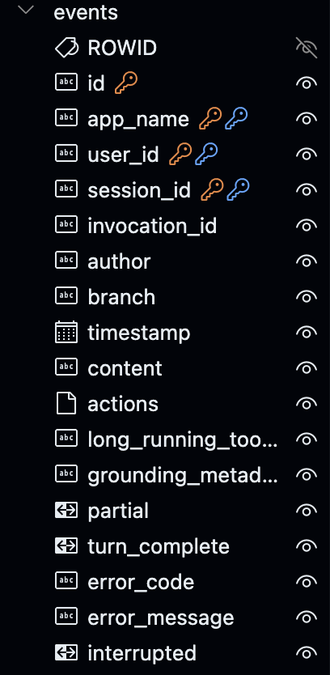
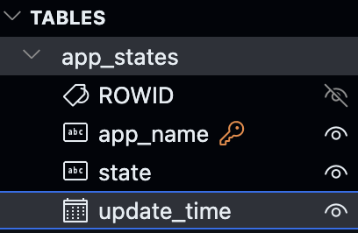
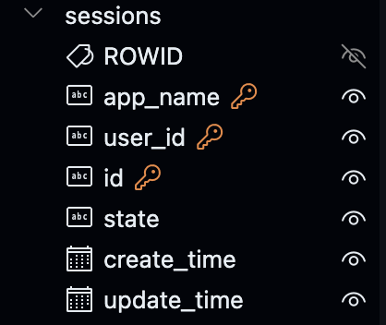
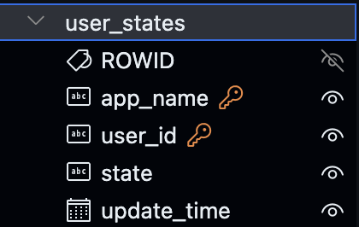
Tables
Notes:
“Python’s async and await are all about handling tasks that wait a lot — like web requests, database queries, or reading files. Normally, Python would block and just sit there until the task finishes. But with async, it can keep working on other things while it waits.
When I mark a function with async, I’m saying: this is a coroutine, it can pause and resume later. Then, when I use await, that’s where the pause actually happens — the function waits there, and the event loop gives time to other tasks.”

Slide 39
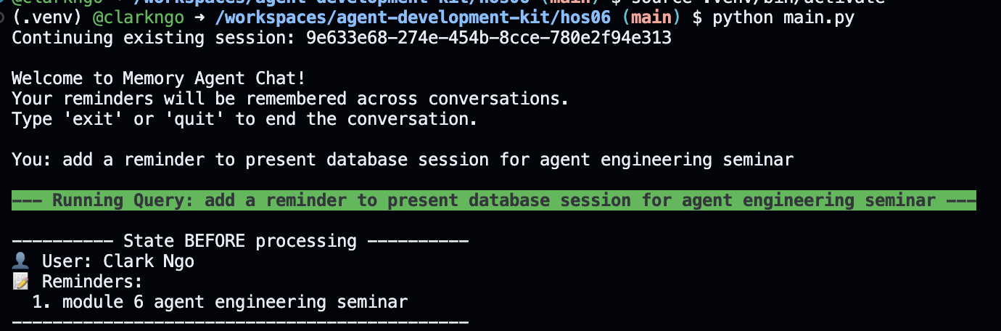
Running the Memory Agent
Notes:
“Python’s async and await are all about handling tasks that wait a lot — like web requests, database queries, or reading files. Normally, Python would block and just sit there until the task finishes. But with async, it can keep working on other things while it waits.
When I mark a function with async, I’m saying: this is a coroutine, it can pause and resume later. Then, when I use await, that’s where the pause actually happens — the function waits there, and the event loop gives time to other tasks.”

Slide 40
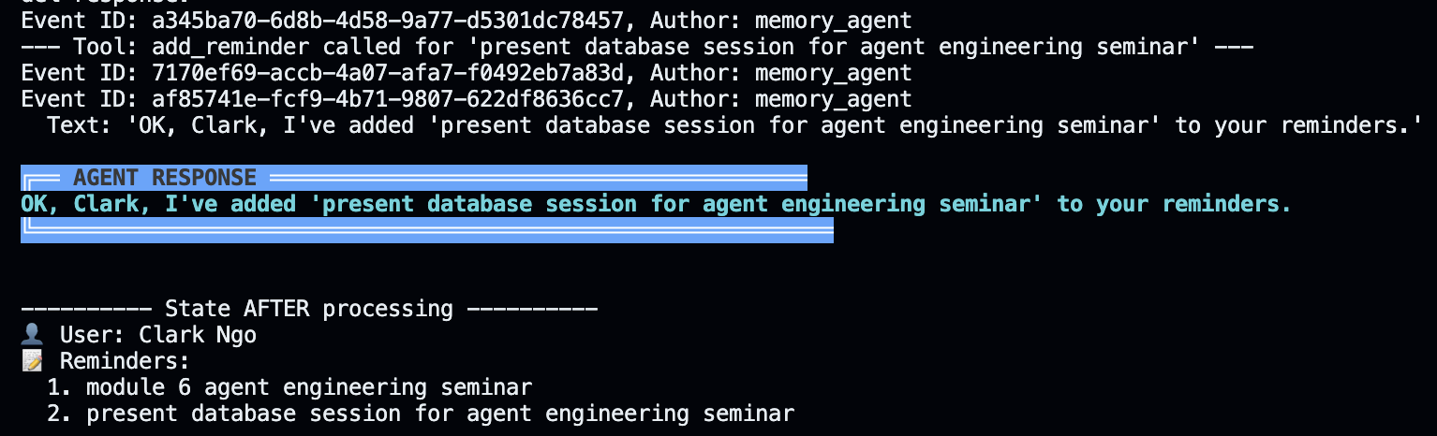
Agent Response and State
Notes:
“Python’s async and await are all about handling tasks that wait a lot — like web requests, database queries, or reading files. Normally, Python would block and just sit there until the task finishes. But with async, it can keep working on other things while it waits.
When I mark a function with async, I’m saying: this is a coroutine, it can pause and resume later. Then, when I use await, that’s where the pause actually happens — the function waits there, and the event loop gives time to other tasks.”

Slide 41
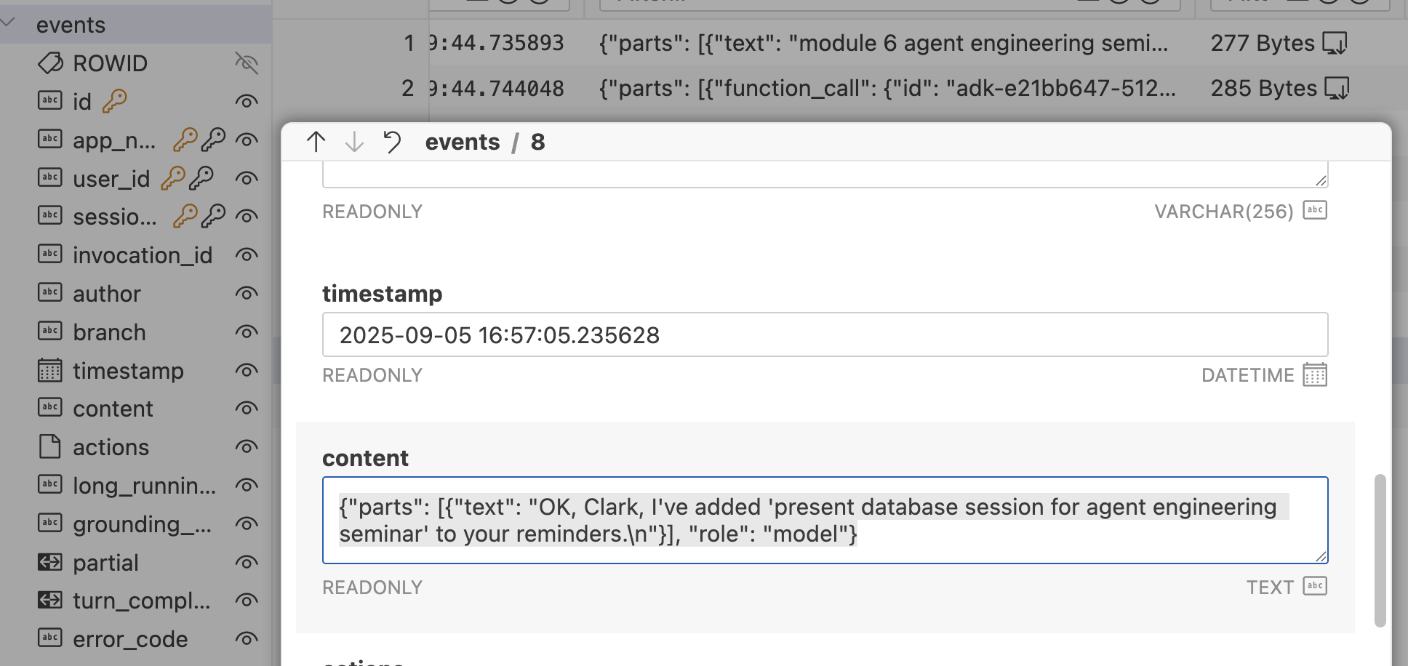
Events Table
Notes:
“Python’s async and await are all about handling tasks that wait a lot — like web requests, database queries, or reading files. Normally, Python would block and just sit there until the task finishes. But with async, it can keep working on other things while it waits.
When I mark a function with async, I’m saying: this is a coroutine, it can pause and resume later. Then, when I use await, that’s where the pause actually happens — the function waits there, and the event loop gives time to other tasks.”

Slide 42
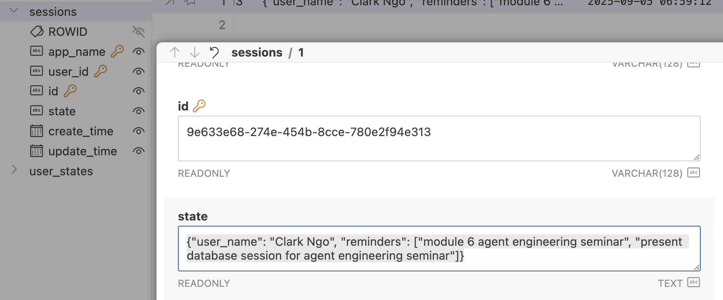
Sessions Table
Notes:
“Python’s async and await are all about handling tasks that wait a lot — like web requests, database queries, or reading files. Normally, Python would block and just sit there until the task finishes. But with async, it can keep working on other things while it waits.
When I mark a function with async, I’m saying: this is a coroutine, it can pause and resume later. Then, when I use await, that’s where the pause actually happens — the function waits there, and the event loop gives time to other tasks.”

Slide 43
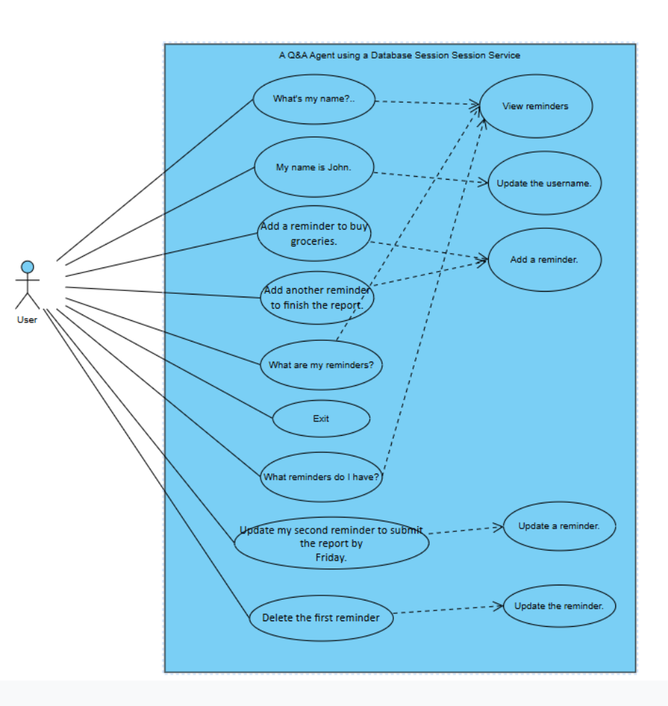
Use Case Diagram

Slide 44
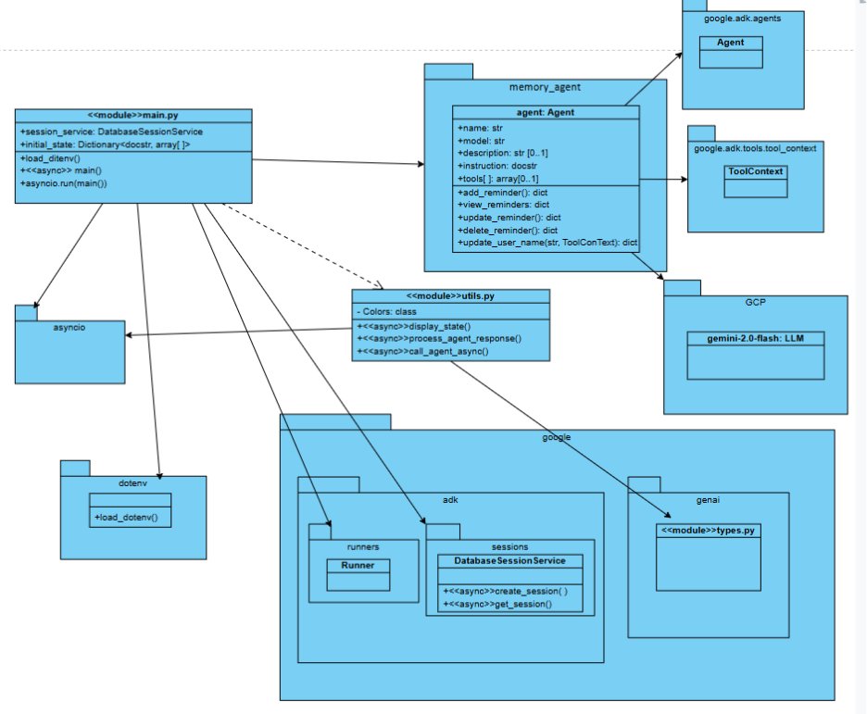
Class Diagram

Slide 45
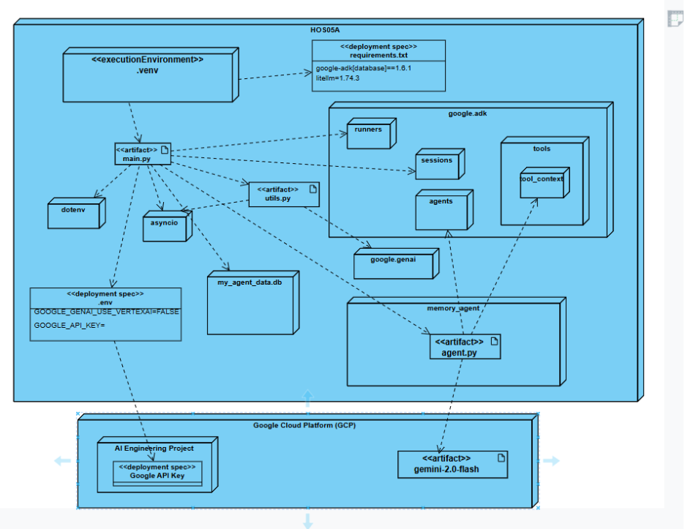
Deployment Diagram

Slide 46
References
Google Agent Development Kit (ADK)
google-adk·PyPI
Gemini models | Gemini API | Google AI for Developers
Brandon Hancock's ADK Crash Course
Module 6: Persistent Storage
Brandon Hancock's ADK Masterclass: Build AI Agents & Automate Workflows (Beginner to Pro) (3:12:47)
Module 6: Persistent Storage (01:14:20 – 01:30:55)
Google. (2025). Agent Development Kit. Github.io. https://google.github.io/adk-docs/agents/llm-agents/#guiding-the-agent-instructions-instruction
W3Schools. (2025). JSON. W3schools.com. https://www.w3schools.com/js/js_json.asp
Pydantic. (2020). Welcome to Pydantic - Pydantic. Pydantic.dev. https://docs.pydantic.dev/latest/
‌

Slide 47

Q&A

